Slide 1
Office 365 Development

Slide 2
Course Agenda
Introduction to Office 365 Development
Module 1: Deep Dive Apps for Office in Outlook
Module 2: Deep Dive Apps for Office in Word
Module 3: Deep Dive Apps for Office in PowerPoint
Module 4: Deep Dive Apps for Office in Excel
Module 5: Deep Dive into SharePoint Hosted Apps
Module 6: Deep Dive into Provider Hosted Apps
Module 7: Deep Dive into Security and OAuth
Module 8: App Lifecycle Management

Slide 3
Deep Dive into Provider Hosted Apps

Slide 4

Agenda
Introduction
Programming in C#
Programming in JavaScript
Chrome Control
Remote Event Receivers

Slide 5
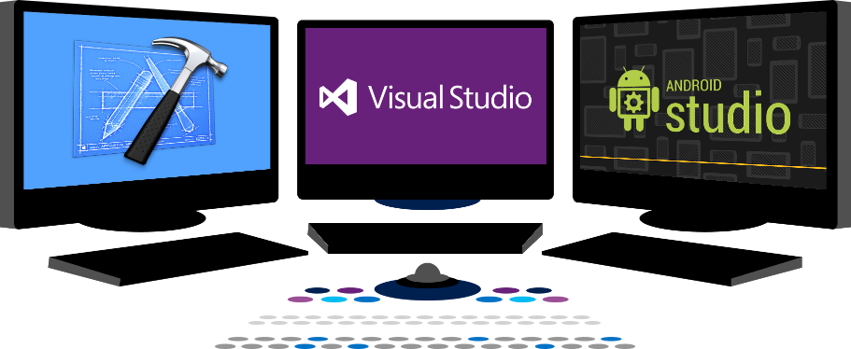














Vision
EXTEND OFFICE EVERYWHERE
CONNECT TO OFFICE 365 SERVICES
BUILD USING AN OPEN PLATFORM
Delve
z
Users and groups
Files
Mail
Calendar
My Apps
Video Portal
Contacts
Office Graph
Presentations
Documents
Spreadsheets
Lync
OneNote
Yammer

Slide 6
Introduction

Slide 7
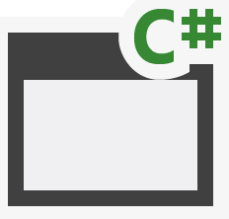
Cloud Architecture
SQL Azure
Azure Web Sites
Azure Data Market
aspx
png
master
CSS
js
SharePoint Online
Host Web
App Web

Slide 8
On-Premises Architecture
Internet Information Server
Databases
Web Services
aspx
png
master
CSS
js
SharePoint 2013
Host Web
App Web

Slide 9
App Permissions
Remote web always has full rights to app web
App permissions are the lesser of user and app permissions to the given resource
Provider-hosted app can utilize “app-only” permissions to “elevate” privileges.

Slide 10
App-Only Permissions
Considers app permissions only, ignores user
Set AllowAppOnlyPolicy to true in AppManifest
Get an app-only token
Notes:
Provider-hosted apps can use “app only” permissions
Update the App manifest to indicate this is OK
Then you need an app-only token in code

Slide 11
Creating Provider-Hosted Apps
Web Project
ASP.NET Web Forms
MVC 5
Authorization
Azure Access Control Services
Server-to-Server High Trust
Programmability
SharePointContextProvider class
Managed CSOM or REST
JavaScript Cross-Domain Library
Notes:
Visual Studio supports both ASP.NET Web Forms and MVC5
On-premises authorization uses S2S
Cloud authorization uses OAuth
The SharePointContextProvider simplifies token management
Managed CSOm and RESt can be used directly from the server side
The cross-domain library can be used from JavaScript

Slide 12
demo
Creating a Provider-Hosted App

Slide 13
Programming in C#

Slide 14
SharePointContextProvider Class
Checks for valid Context Token
Redirects if it does not exist
Simplifies the management of context
Provides an ACS or STS context
Context exposes properties for key values like Host Web URL
Simplifies the management of tokens
Context exposes methods to retrieve tokens
Notes:
The SharePointContextProvider simplifies the management of context, and tokens
It uses a cookie to store the CacheKey, and stores the actual token in session state on the server referenced by the cache key
All of this improves performance and makes programming easier

Slide 15
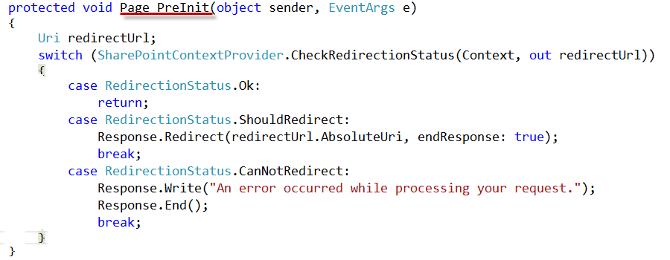
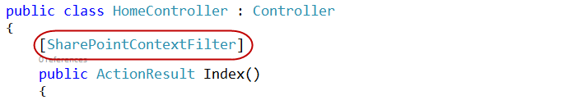
Validating Context Token
Web Forms
MVC 5
Notes:
ASP.NET Web Forms uses the PreInit method to validate the Context Token
Notice how it will redirect if the token is not valid
ASP.NET MVC 5 uses a filter to run essentially the same code
Notice how the filter attribute is applied to the controller

Slide 16
Managing SharePoint Context
SharePointContextProvider GetSharePointContext
Returns SharePointAcsContext in cloud
Returns SharePointHighTrustContext on premises
Properties
SPAppWebUrl
SPClientTag
SPHostUrl
SPLanguage
SPProductNumber
Notes:
SharePointAcsContext and SharePointHightTrustContext both inherit from SharePointContext
This means that the same code works in both cloud and on-premises environments

Slide 17
Managing Security Tokens
CSOM
CreateAppOnlyClientContextForSPAppWeb
CreateAppOnlyClientContextForSPHost
CreateUserClientContextForSPAppWeb
CreateUserClientContextForSPHost
REST
AppOnlyAccessTokenForSPAppWeb
AppOnlyAccessTokenForSPHost
UserAccessTokenForSPAppWeb
UserAccessTokenForSPHost
Notes:
The SharePointContext makes it easy to get the tokens you need

Slide 18
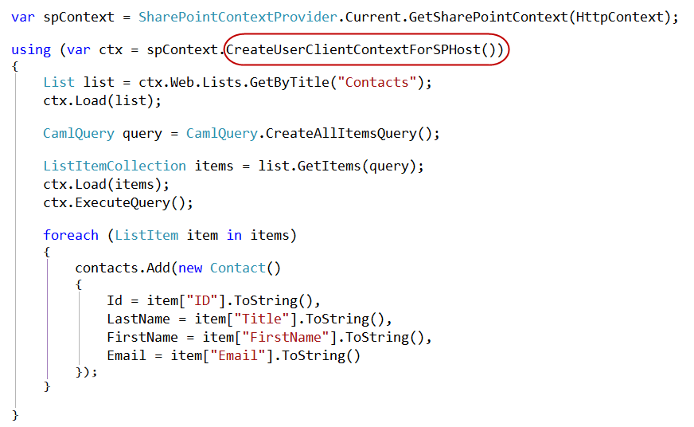
Managed CSOM

Slide 19
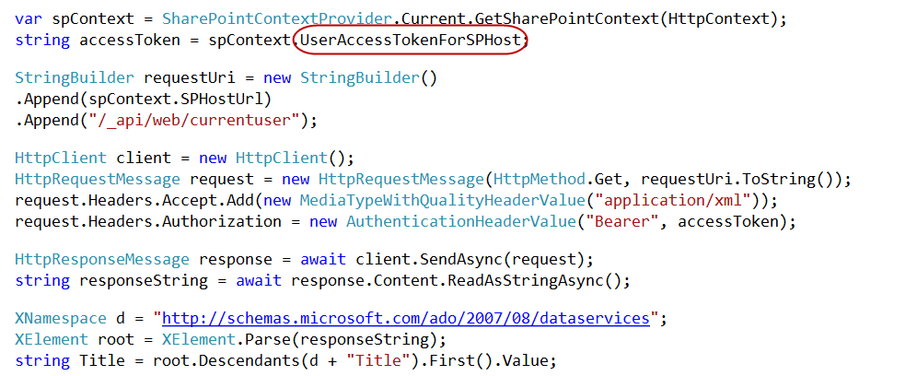
Managed REST

Slide 20
demo
C# Code in a Provider-Hosted App

Slide 21
Programming in JavaScript

Slide 22
Managing SharePoint Context
SPContext.js Library part of project template
Appends SPHostUrl as query string to all the links which point to current domain
Notes:
This is an optional component
You could also use HTML5 to build your own cache
But you really need to save the standard tokens because you will need them on other pages in the app
That’s the basic problem: you need the standard tokens in many places, so you can cache them or pass them along

Slide 23
Cross Domain Library
Same-domain policy prevents JavaScript from making direct calls to either the app web or host web from the remote web
Required to make JavaScript calls to both the app web and host web
Notes:
Makes it possible to call the app web or host web from JavaScript in the remote web

Slide 24
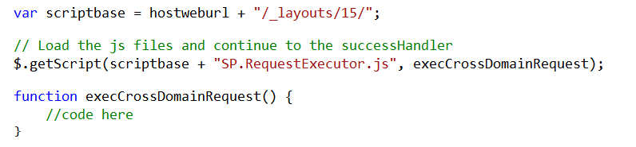
Loading the Cross-Domain Library
SP.RequestExecutor.js located in LAYOUTS directory
Option 1: Copy and include directly in your app
Option 2: Load Dynamically using jQuery

Slide 25
Cross-Domain Library Architecture
Web Page
IFRAME
App Web
AppWebProxy.aspx
SP.RequestExecutor.js
AppWebProxy.aspx
Remote Web
SharePoint
Notes:
The remote web loads the SPRequestExecutor.js library
The remote web create a new SP.RequestExecutor object, initializing it with the URL of the app web
This causes a hidden IFRAME to be created, which loads APPWebProxy.aspx from the LAYOUTS directory
The SP.RequestExecutor object uses the HTML5 postmessage command to send requests from the remote web
The request is executed by the AppWebProxy.aspx page
The response is returned

Slide 26
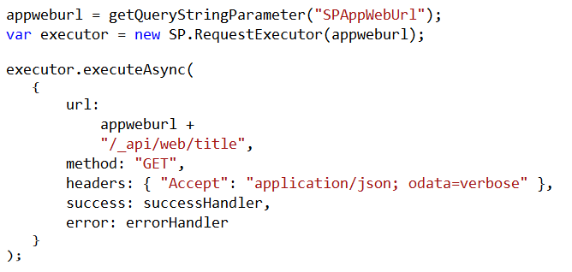
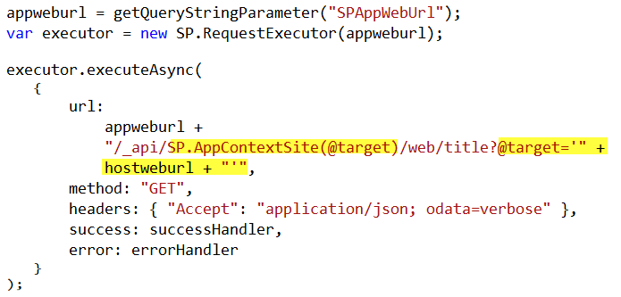
Cross-Domain REST Calls
Call targeting App Web
Call targeting Host Web
Notes:
When calling the host web, you must switch the context

Slide 27
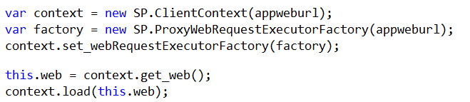
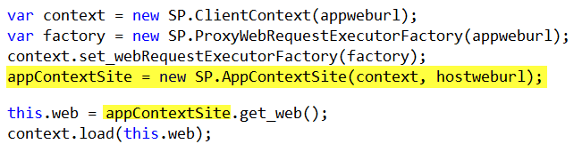
Cross-Domain CSOM Calls
Call targeting App Web
Call targeting Host Web
Notes:
When calling the host web, you must switch the context

Slide 28
demo
The Cross-Domain Library

Slide 29
The Chrome Control

Slide 30
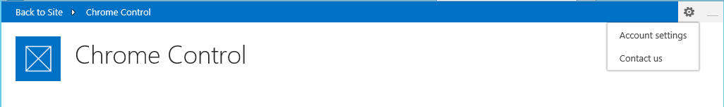
Chrome Control
JavaScript Component for creating basic banner and navigation elements
Notes:
When you create a remote web, it’s nice to have it borrow some of the characteristics of the host web
This way, it doesn’t surprise the user by changing the UI drastically

Slide 31
Loading the Chrome Control
SP.UI.Controls.js located in LAYOUTS directory
Option 1: Copy and include directly in your app
Option 2: Load Dynamically using jQuery

Slide 32
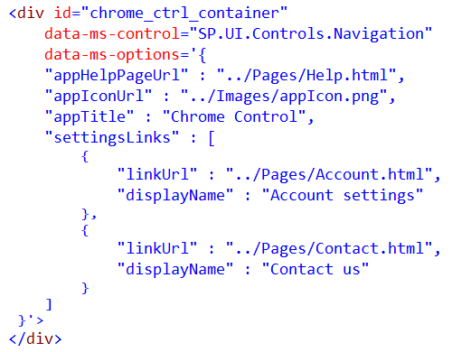
Chrome Control (Declaratively)
Notes:
Create a div tag
Use the attributes data-ms-control and data-ms-options
The chrome control will look for these attributes and render itself in this div

Slide 33
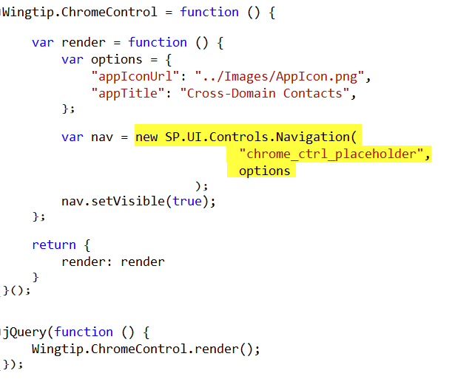
Chrome Control (Programmatically)
Notes:
Here a new chrome control is created in code
When created, it expects you to supply the options and the ID of the div where it should render
Then it renders itself in the div

Slide 34
demo
The Chrome Control

Slide 35
Remote Event Receivers

Slide 36
Remote Event Handlers
Event Handler code runs in remote web
Deployed as web service in remote web
Two-way events
“Before” events (a.k.a, “ING” events)
Synchronous call
Supports a return value
One-way events
“After” events (a.k.a, “ED” events)
Asynchronous call
No return value
Notes:
The event handler infrastructure follows the same pattern as the in-process handlers of old
We have both “before” and “after” event
These are also known as “ING” and “ED” events like “ItemAdding” and “ItemAdded”
Two-way events are synchronous

Slide 37
Supported Events
 | Site | List | List Schema | List Item | App
Create | X | X | X | X
Update |  |  | X | X
Delete | X | X | X | X
Move | X |  |  | X
Check-In |  |  |  | X
Uncheck-In |  |  |  | X
Check-out |  |  |  | X
Attachments |  |  |  | X
File Move/Convert |  |  |  | X
Install |  |  |  |  | X
Uninstall |  |  |  |  | X
Update |  |  |  |  | X

Slide 38
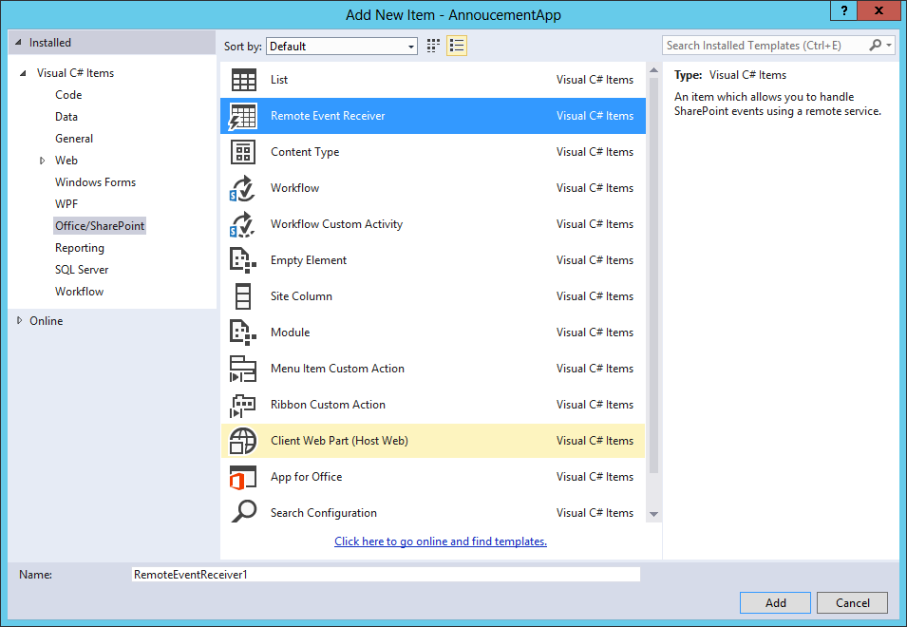
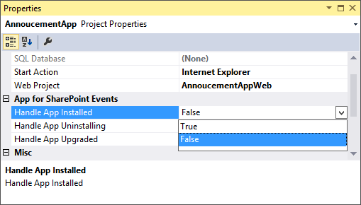
Adding a Remote Event Receiver
Use the “Add New” dialog
For Site, List, Item, and
Schema events
Use the “Properties” dialog
for App events

Slide 39
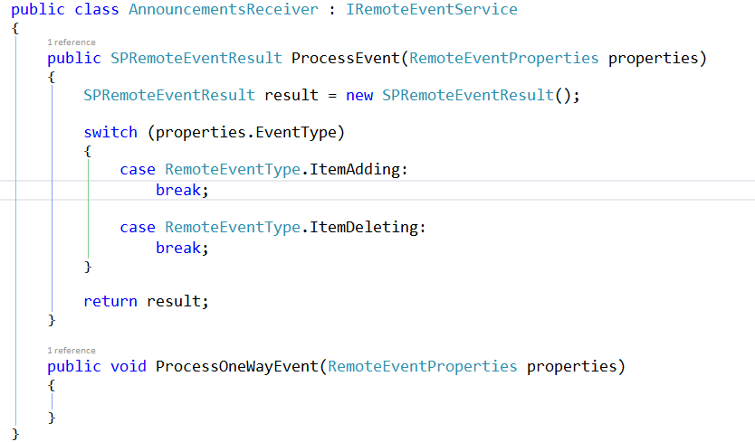
IRemoteEventService
Must be implemented by the remote web service

Slide 40
SPRemoteEventProperties
Passed to web service in response to event
Provides contextual information
Supports reading and updating user inputs
Allows for data validation

Slide 41
SPRemoteEventResult
Returns by two-way events
Allows events to be cancelled
Allows status to be returned

Slide 42
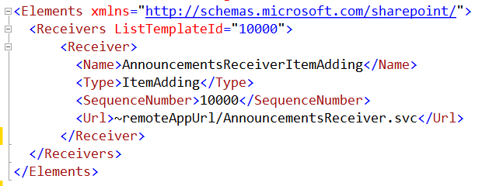
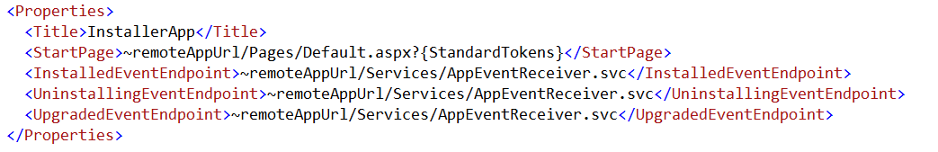
Registering Events Receivers
CAML Element for Lists, Items, Sites, Schema events
App Manifest for
App events

Slide 43
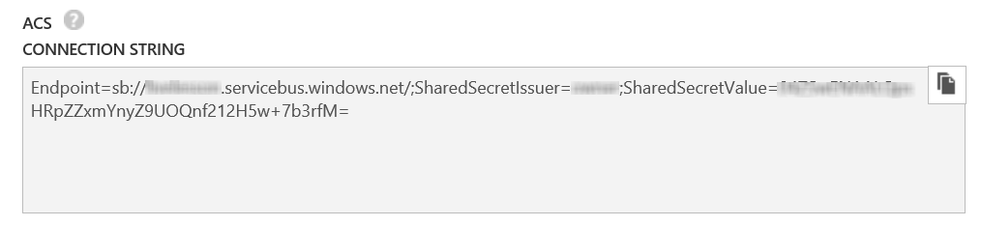
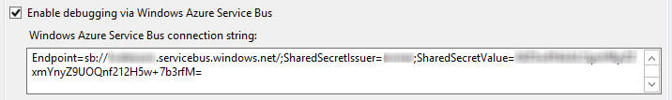
Debugging Considerations
Remote Event Receivers might require Azure Service Bus to support debugging
Create a Service Bus Namespace
Copy the Connection String into the SharePoint Project Properties
Notes:
Note that as of this writing, the Visual tooling only supports ACS strings
The Azure interface only creates SAS strings
So, you have to use PowerShell
Download and Install Azure PowerShell environment
Open PS window
Add-AzureAccount to sign in
New-AzureSBNamespace –Name “myns” -Location “Central US”
Results in an ACS string copy this to Visual Studio

Slide 44
demo
Remote Event Receivers

Slide 45
Summary
Introduction
Programming in C#
Programming in JavaScript
Chrome Control
Remote Event Receivers

Slide 46



dev.office.com
Sign up
http://dev.office.com/getting-started
Explore
http://apisandbox.msdn.microsoft.com
Get trained http://dev.office.com/training

Slide 47


Feedback
Office 365 Network Share you best practices and join conversations https://www.yammer.com/itpronetwork
Stackoverflow Ask deep technical questions to a world-wide set of developers
http://stackoverflow.com/questions/tagged/ms-office
UserVoice Provide suggestions of what you want in future versions
http://officespdev.uservoice.com/

Slide 48

© 2012 Microsoft Corporation. All rights reserved. Microsoft, Windows, and other product names are or may be registered trademarks and/or trademarks in the U.S. and/or other countries.
The information herein is for informational purposes only and represents the current view of Microsoft Corporation as of the date of this presentation. Because Microsoft must respond to changing market conditions, it should not be interpreted to be a commitment on the part of Microsoft, and Microsoft cannot guarantee the accuracy of any information provided after the date of this presentation. MICROSOFT MAKES NO WARRANTIES, EXPRESS, IMPLIED OR STATUTORY, AS TO THE INFORMATION IN THIS PRESENTATION.

